Slide 1

Factors determining economic growth
By Panagiotis Leontsinis , Muhammad AZMI and, Gabija Suruda

Slide 2
Chosen topic
My aim of this project is to produce a website with visual data regarding factors determining economic growth
Economic growth occurs when there is an increase in the production and consumption of goods and services.
For example, Gross Domestic Product (GDP) can be used as a measure for economic growth.
Macroeconomic factors:
GDP per capita
Investment
Government spending
Consumption

Slide 3
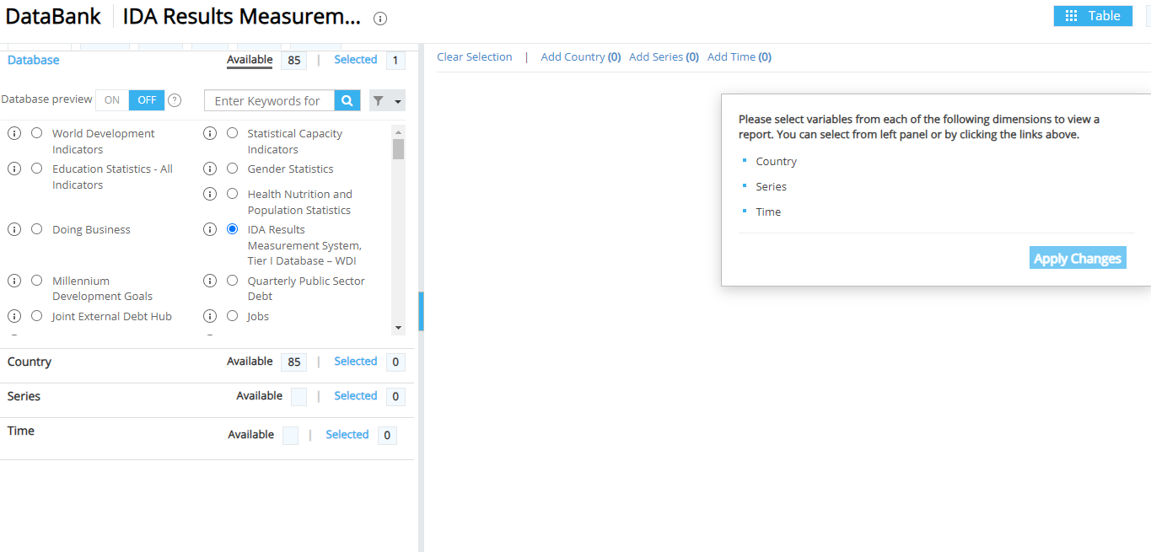
Dataset#1
The World Bank's data portal, databank.worldbank.org, provides global development, economic, social, and environmental data
https://databank.worldbank.org/source/ida-results-measurement-system,-tier-i-database-%e2%80%93-wdi

Slide 4
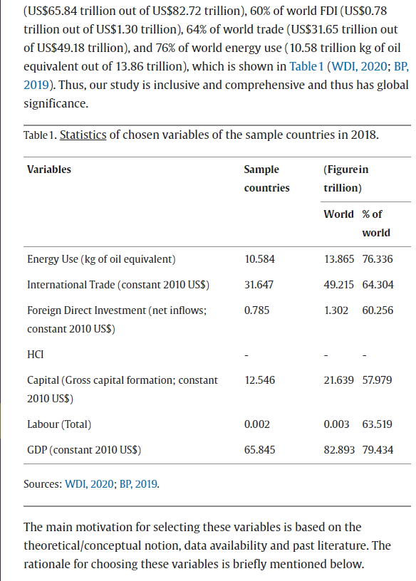
Dataset#2
Science direct provides access to a collection of peer-reviewed journals, articles, and research papers
https://www.sciencedirect.com/science/article/pii/S2405844021012123?via%3Dihub

Slide 5
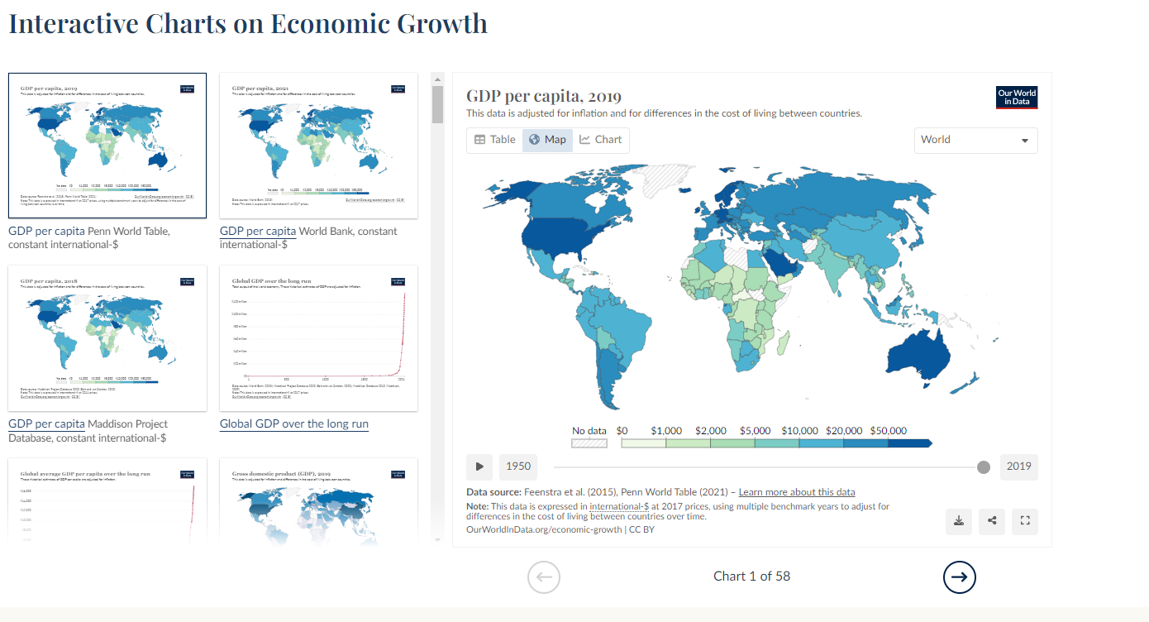
Dataset#3
The website provides accurate and up-to-date information, and their work is often cited in academic research and media reports
https://ourworldindata.org/economic-growth#research-writing

Slide 6
Limitations of datasets
Data Accuracy and Reliability:
May contain errors or inaccuracies due to data collection methods, bias, or incorrectly measured data
Time relevancy:
Economic data may involve time lags
Currency and Inflation Adjustments:
Account for currency fluctuations or inflation adjustments
Political and external factors:
Economic data can be influenced by political factors, such as governments
May not fully account for the impact of external shocks

Slide 7
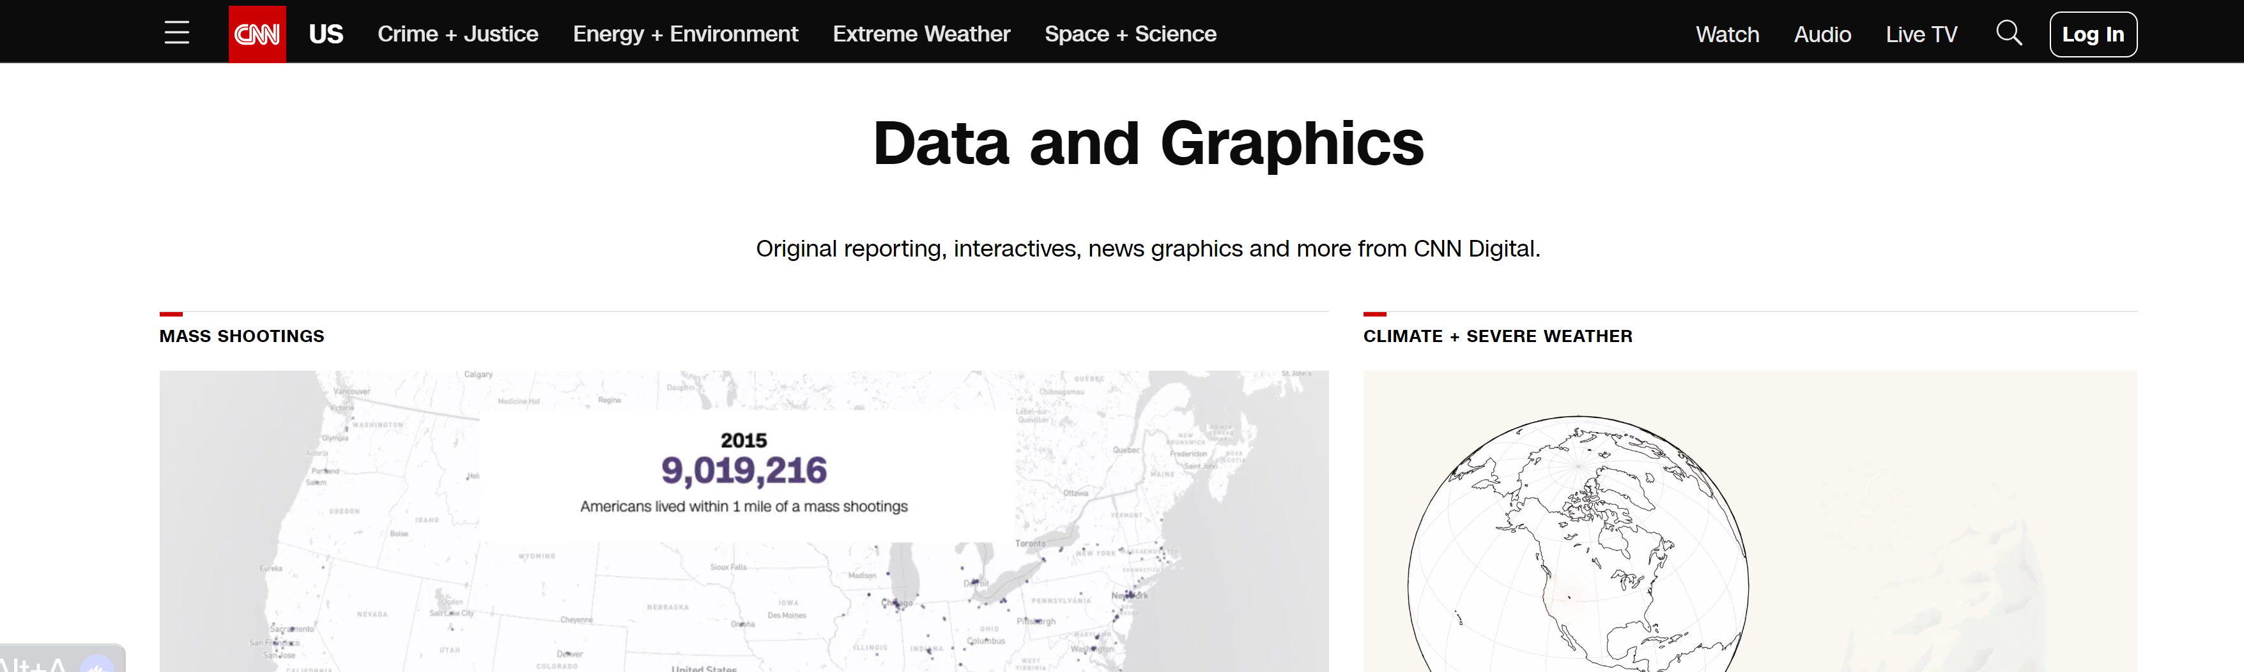
Visualisation

Slide 8
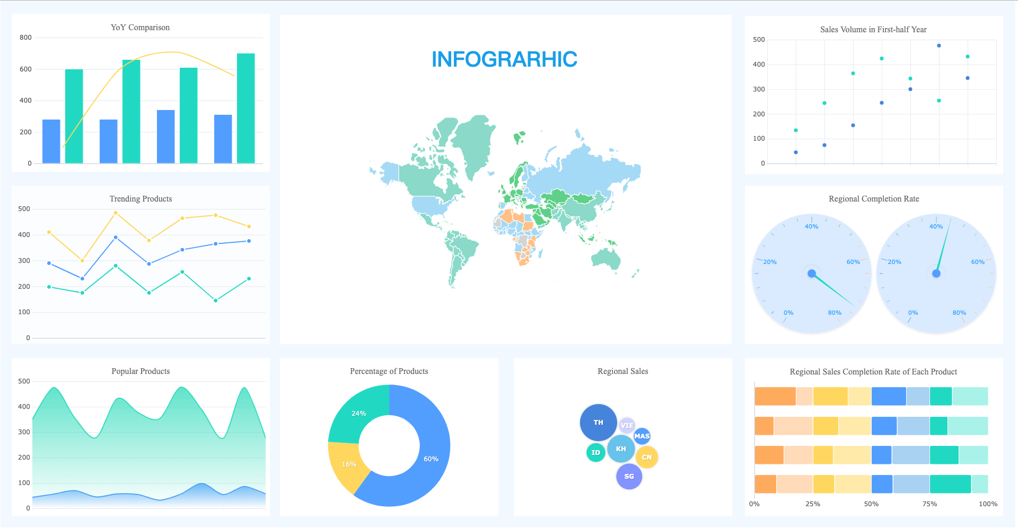
Visualisation

Slide 9
Aesthetic choices
Interactive page will capture users' attention and engage them to explore the data visualizations
Interactive elements like tooltips, zooming, and filtering to enhance user engagement
User-Friendly Navigation
Relevant and high-quality images that complement the content
Readable and modern fonts
Clean and cohesive color scheme

Slide 10
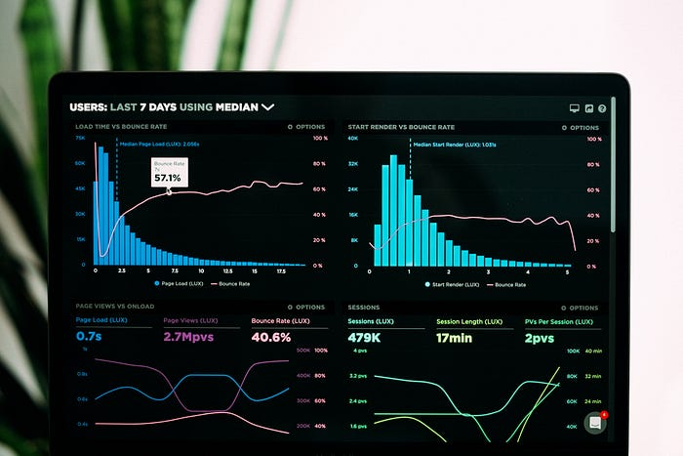
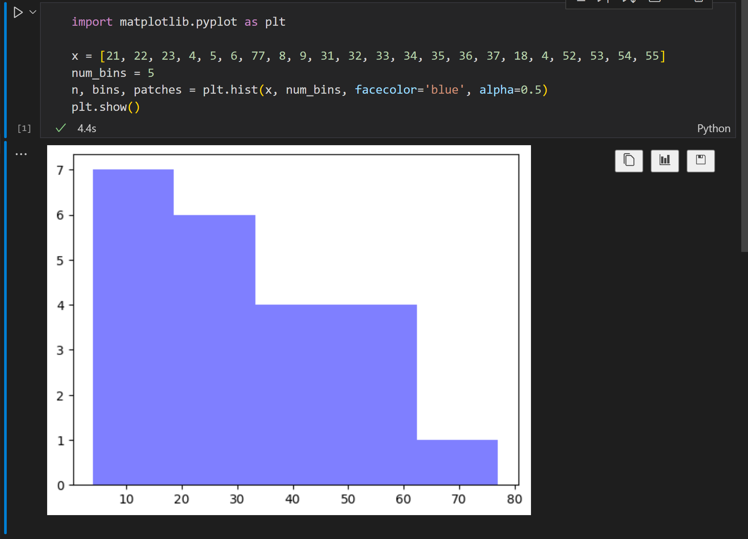
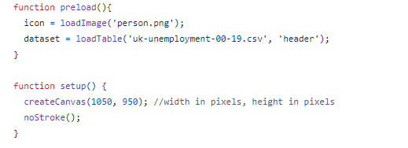
Technical choices
https://towardsdatascience.com/how-to-do-visualization-using-python-from-scratch-651304b5ee7a
This code will load the image 'person.png' along with a table named uk-unemployment which is a csv file. A csv file is an excel file format for tables. Furthermore, the second function will create the canvas with the specific width and height.

